Slide 1
Welcome To The year Three information meeting

Slide 2
Learning & Communication
Topic overview
Trips
Homework
Website signposting
Communication

Slide 3
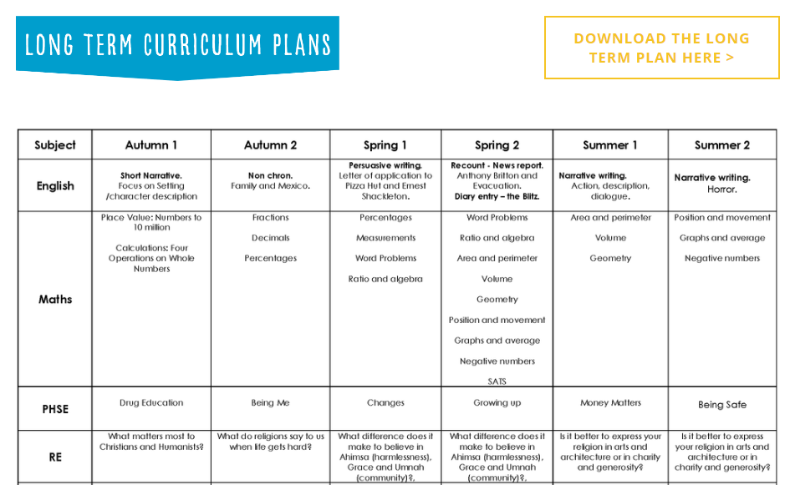
Topic overview
Knowledge Organiser and Long Term Plan
Home
Our School
Year 3 Knowledge Organiser/ Long Term Plan
(Overview of the Year Group learning throughout the year)
A closer look at subjects
Home
Curriculum
Select a subject
Progression Document
(Overview of the learning in that subject across the year groups)
Helpful website suggestions

Slide 4
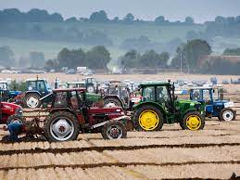
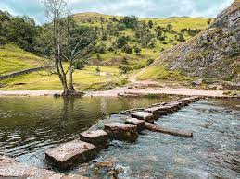
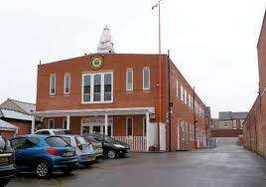
Trips and Visitors
- Ploughing Match – Carr Farm 2023
- Dovedale
- St Augustine’s Church
- Hindu Temple
- Local library
- Reverend Tito

Slide 5
Homework
Focus on basic skills
Maths - Fluency and arithmetic
- TT Rock Stars
Spelling- Year 3 and 4 Words or spelling patterns appropriate to classroom learning
Reading Expectations- Daily and sign Reading Record

Slide 6
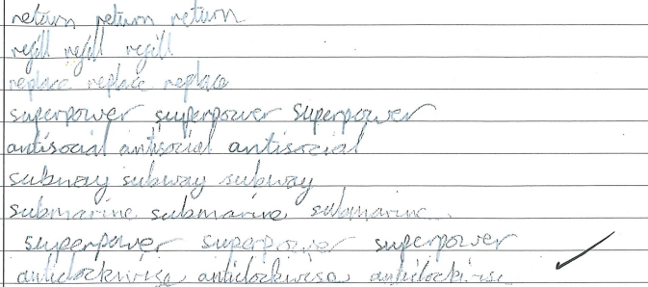
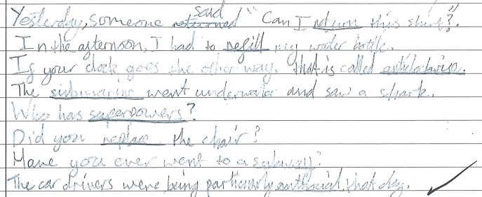
Homework Literacy Example

Slide 7
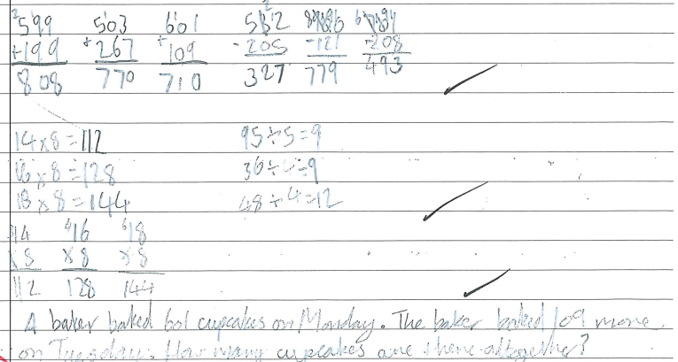
Homework Numeracy example

Slide 8
Website Signposting
https://www.dale.derby.sch.uk/

Slide 9
Communication
A member of the Leadership team on the school gates at the beginning and end of the school day
Classroom Teachers available for a quick message when dismissing children at the end of the day or to arrange a convenient time for a longer conversation
Call the office to arrange a meeting with the class teacher if a longer conversation is needed

Slide 10
Expectations and Behaviour
The School Day
School Rules
Rewards/ Consequences
Attendance
School Uniform

Slide 11
The School Day
The school day begins at 8.40- Learning begins in classrooms at 8.40
Register closes at 9am
Arrival after 9am- recorded as ‘Late’ and will impact overall attendance
At break children can bring in a healthy snack (no sweets or chocolate bars)

Slide 12
School Rules
The three school rules are displayed in every classroom and around the building. These are:
• Ready
(All children should be ready to learn)
• Respect
(All children should show respect for everyone and everything)
• Safe
(All children should keep themselves and others safe)
At the start of each year, each class will discuss and agree what Ready, Respect, Safe means for their class using age appropriate language and concepts.
This policy will also be adhered to outside of school and the same high standards of behaviour will be expected e.g. walking to the park, on residential visits, school trips and at events.
Notes:
The school rules are outlined in the Behaviour policy. They are referred to throughout the school day- used as a common language so that children are familiar with them and their importance. Teachers discuss each rule and explicitly encourage children to think about what each looks like- in the classroom, on the playground, walking through school, on a trip- in every situation. Also- what doesn’t each rule look like in those situations- what should the teacher see/ what shouldn’t the teacher see.

Slide 13
rewards
Expectations of positive behaviour form the basis of our reward system
C
O
L
L
A
B
O
R
A
T
E
Notes:
Go through each one and explain how each reward works and why we have it- e.g. collaborate- to encourage chn to work together, be kind, respectful and co-operative

Slide 14
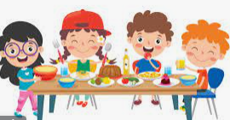
rewards
Good Work Assembly… Half Termly Book Prize…
In each class, 3 children are chosen and a book is given as a prize to reward:
Attendance
Kindness
Reading
Top Table
Notes:
Explain each reward

Slide 15
Consequences
We focus on positive behaviour
If children are struggling we follow a clear system
Reminder
Warning
Last Chance
Time to Think
Repair
If children are given ‘Time to Think’ a consequence may also be given such as;
Missing playtime
Missing lunchtime
Phone calls home may also be made

Slide 16
Attendance & rewards
“Data from 2019 shows that 84% of Key Stage 2 pupils who had 100% attendance achieved the expected standard, compared to 40% of pupils who were persistently absent across the key stage.”
“Being in school is important to your child’s achievement, wellbeing, and wider development. Evidence shows that the students with the highest attendance throughout their time in school gain the best GCSE and A Level results.
Our research found that pupils who performed better both at the end of primary and secondary school missed fewer days than those who didn’t perform as well.”
Department for education
Notes:
Talk about the curriculum and progression- one year feeds into the next- if chn have lots of gaps in their learning they struggle to connect new learning.

Slide 17
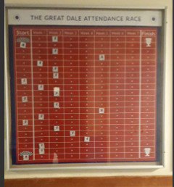
Attendance & rewards
Half termly cake –class who wins race
Weekly trophy for class with best attendance
School trip – bowling for excellent attendance
End of year improved attendance- shopping voucher for family

Slide 18
School & PE Uniform
School Uniform
School website
home page
parent info
school uniform
Notes:
Click link (school uniform) to share web page with parents
Be clear that black school shoes must be worn- not black trainers
PE Uniform- PE uniform can be bought at reasonable prices from shops such as Asda, Sainsburys etc

Slide 19
Internet safety
Issues
Age Limits
Parental Controls and advice

Slide 20
Issues
Increased number of friendship issues linked to time spent online
Children have access to APPs and online platforms beyond their age limit
Learning and teaching time is taken up dealing with these issues
Notes:
Chn don’t always have the maturity to deal with the content

Slide 21
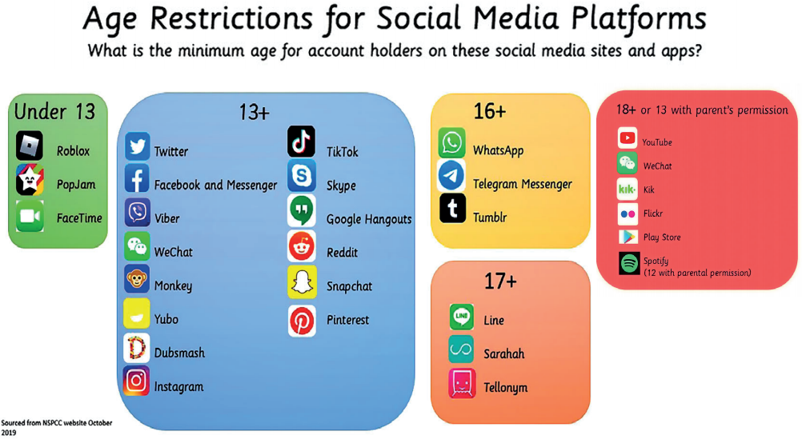
Age Limits

Slide 22
Parental Controls and Advice
Internet Safety Guidance
Search Internet Matters
Young Children (6-10)
Take Control…

